Slide 1
Social and Economic Indicators

Slide 2
Social and economic indicators in nutrition—including household income, education level, occupation, and access to resources—critically dictate dietary quality, food security, and health outcomes.
Lower socioeconomic status often correlates with higher rates of undernutrition, stunting, and wasting, as well as obesity due to poor dietary intake.

Slide 3
Key Socio-Economic Indicators Affecting Nutrition:
Income and Wealth: Higher income allows for purchasing more diverse, nutritious foods, while poverty restricts choices to cheaper, less nutritious options.
Education Level: Parental education (especially maternal) is a key determinant of child nutrition and family dietary habits.
Occupation and Employment: Stable employment improves, and often dictates, household food security and access to healthcare.

Slide 4
Food Environment and Access: Proximity to supermarkets vs. fast-food outlets, as well as access to clean water and sanitation, affects dietary choices and nutrient absorption.
Housing and Amenities: Quality of housing and access to utilities impact overall health and the ability to prepare nutritious meals.

Slide 5
Key Nutritional Outcomes Linked to Indicators:
Stunting and Wasting: Prevalent in low-income, low-education environments.
Dietary Diversity: Higher socioeconomic groups consume more fruits, vegetables, and fiber.
Obesity and Non-Communicable Diseases (NCDs): Often linked to lower socioeconomic status in developed countries, leading to high-fat, high-sugar diets.
Food Insecurity: Measured by the inability to access sufficient, safe, and nutritious food.

Slide 6
These indicators are essential for assessing inequalities, with tools like the Global Hunger Index measuring undernourishment, child mortality, and child malnutrition to track these trends.

Slide 7
The Global Hunger Index is an annual peer-reviewed report by Concern Worldwide and Welthungerhilfe that measures and tracks hunger at global, regional, and national levels.
It ranks countries on a 100-point scale based on four indicators: undernourishment, child stunting, child wasting, and child mortality.

Slide 8
Index has been released by Irish humanitarian organization 'Concern Worldwide' and German aid agency 'Welthungerhilfe' (with UNICEF, WHO).
Purpose of Index is to track hunger globally using nutrition & mortality indicators.
Each country's GHI score is calculated based on a formula that combines four indicators:
  Undernourishment (Insufficient caloric intake);
  Child stunting (Children with low height under age 5);
  Child wasting: (Children with low weight for their height under age 5);
  Child mortality: (Children who die before their fifth birthday)

Slide 9
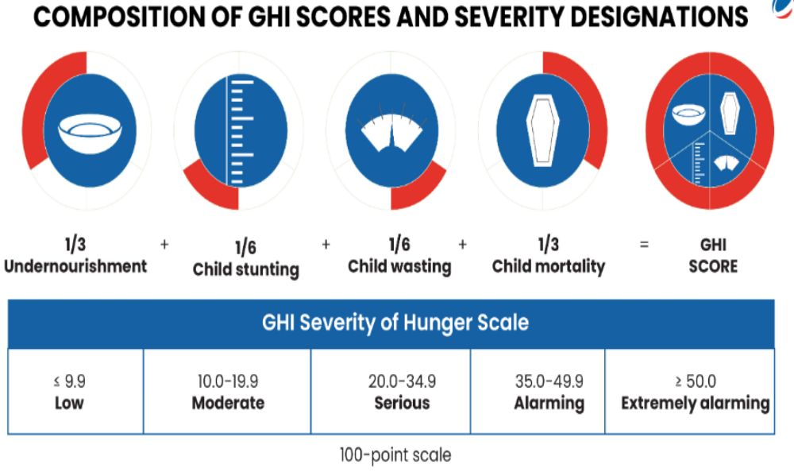

Slide 10
Nutrition surveys
The nutritional status of a selected popu­lation group is often assessed by means of a cross-sectional survey. The survey may either establish baseline nutritional data or ascertain the overall nutritional status of the popu­lation. Cross-sectional nutri­tion surveys can be used to examine associations, and to identify and describe popu­lation subgroups “at risk” for chronic malnu­trition.
National cross-sectional nutri­tion surveys generate valuable infor­mation on the preva­lence of existing health and nutritional problems in a country that can be used both to allocate resources to those popu­lation subgroups in need, and to formulate policies to improve the overall nutri­tion of the popu­lation.

Slide 11
Nutrition surveillance
The characteristic feature of surveillance is the continuous monitoring of the nutritional status of selected popu­lation groups.
Surveillance studies therefore differ from nutri­tion surveys because the data are collected, analyzed, and utilized over an extended period of time. Sometimes, the surveillance only involves specific at‑risk subgroups, identified in earlier nutri­tion surveys.

Slide 12
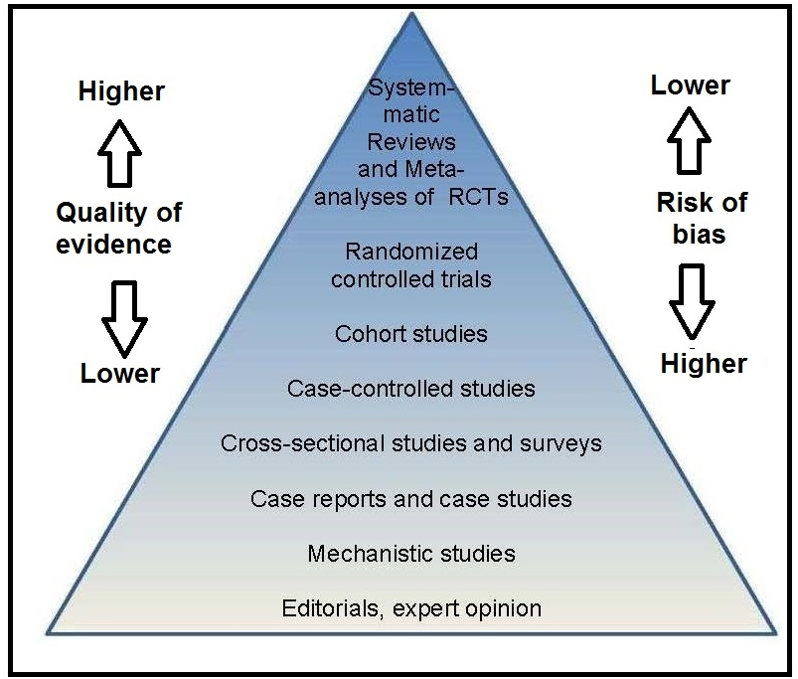

Slide 13
